Slide 1
Fake Job Postings Detection using NLP
Team Members:
Arja Raghuveer
Amish garg
Kemburu satyavathi
Jonnada Vennela

Slide 2
DATA COLLECTION
Source: Kaggle- https://www.kaggle.com/datasets/shivamb/real-or-fake-fake-jobposting-prediction (fake_job_postings.csv)
Columns: job_id, title, location, department, salary_range, company_profile, description, requirements, benefits, telecommuting, has_company_logo, has_questions, employment_type, required_experience, required_education, industry, function, fraudulent.
Focus: description → target: fraudulent
Dropped rows with empty descriptions.
Dataset size: 17880 rows X 18 columns

Slide 3
libraries
pandas
re
string
BeautifulSoup
nltk
stopwords
word_tokenize
WordNetLemmatizer
train_test_split
TfidfVectorizer
LogisticRegression

Slide 4
Text Preprocessing
Remove missing
Remove HTML tags (BeautifulSoup)
Convert text to lowercase
Remove punctuation & numbers
Tokenize words (NLTK)
Remove stopwords (the, is, a…)
Remove short words (<3 letters)
Lemmatization (running → run)

Slide 5
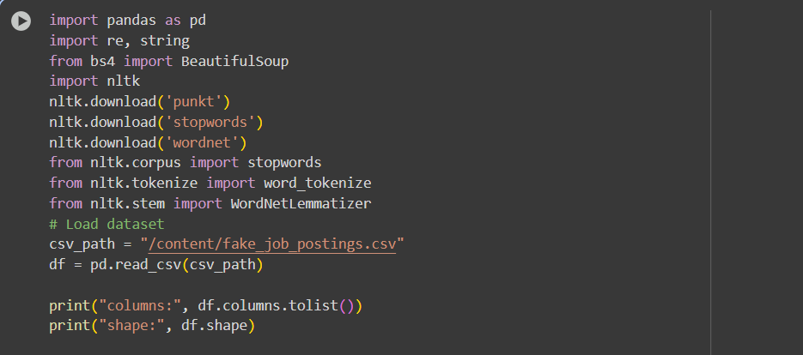

Slide 6
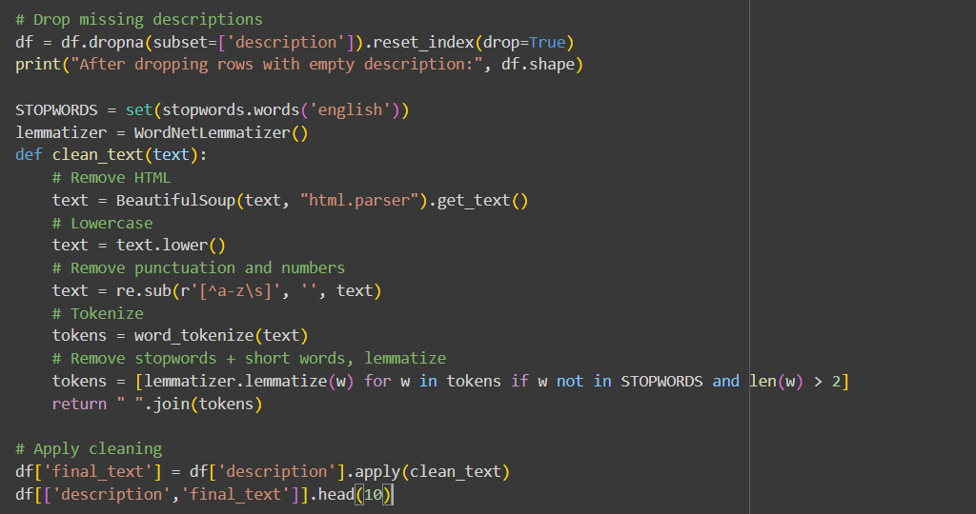

Slide 7
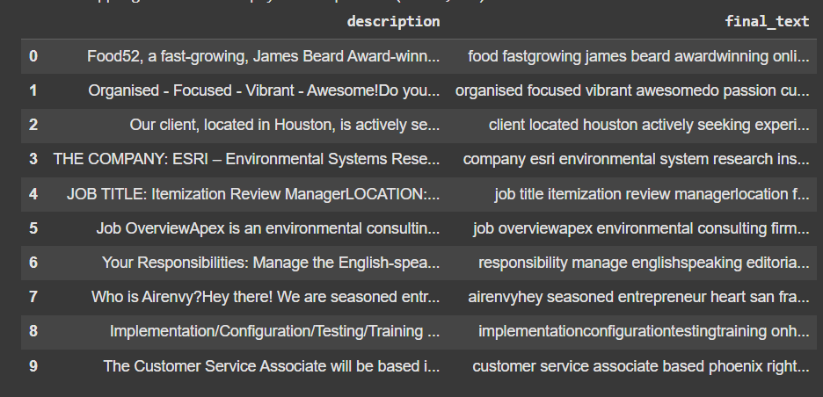
Output after data preprocessing

Slide 8
Feature Extraction (TF-IDF)
from sklearn.feature_extraction.text import TfidfVectorizer
TF-IDF vectorizer converts text into numerical vectors by calculating the importance of words within a document relative to a collection of documents (corpus)
Captures word importance across documents
Limited to top 5000 words (max_features=5000)

Slide 9
Train-Test Split
from sklearn.model_selection import train_test_split
Dividing a dataset into two distinct subsets:
Training Set: data is used to "train"
Testing Set: evaluated done on this unseen testing set
80% training, 20% testing
random_state=42 (primary purpose is to ensure reproducibility of your results)

Slide 10
Model
from sklearn.linear_model import LogisticRegression
machine learning algorithm that predicts the probability of a binary outcome
Binary classification: 0 = Real, 1 = Fraudulent
Input: TF-IDF features → Output: Predicted label

Slide 11
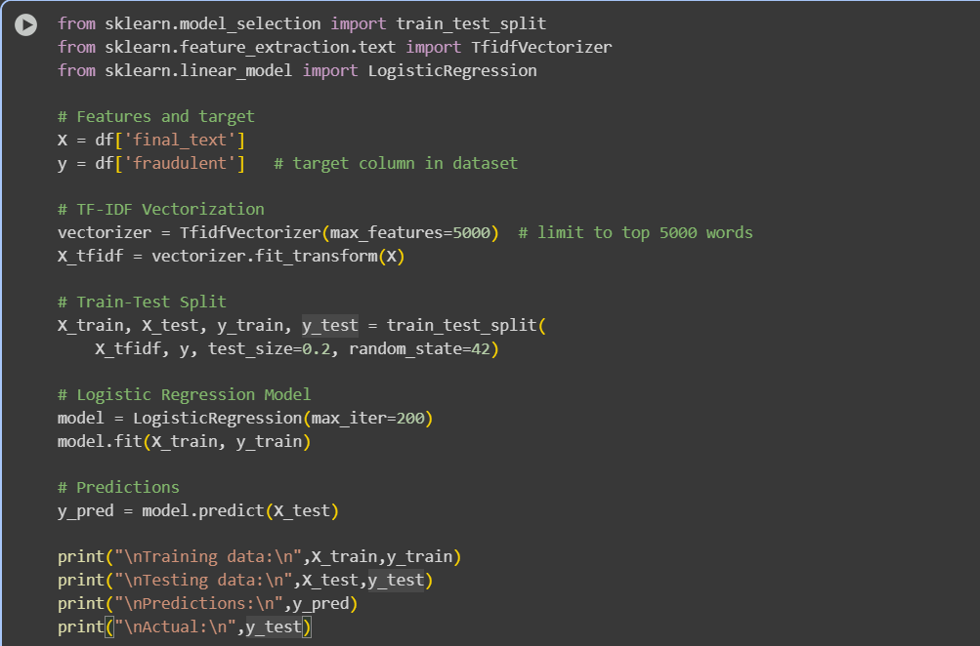

Slide 12
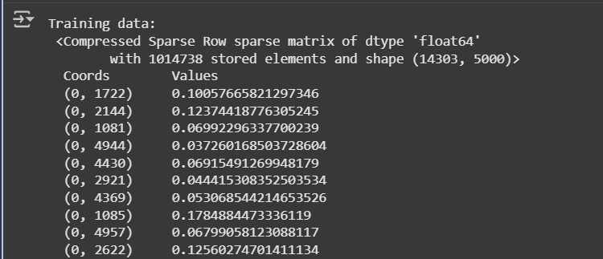
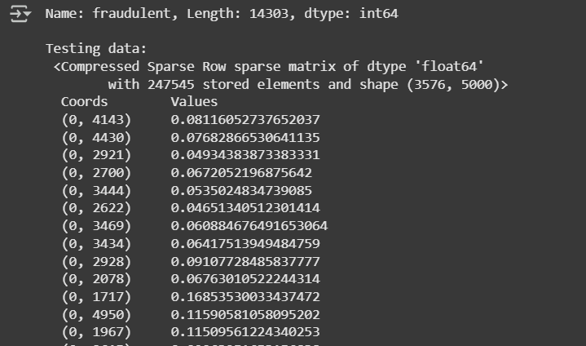

Slide 13
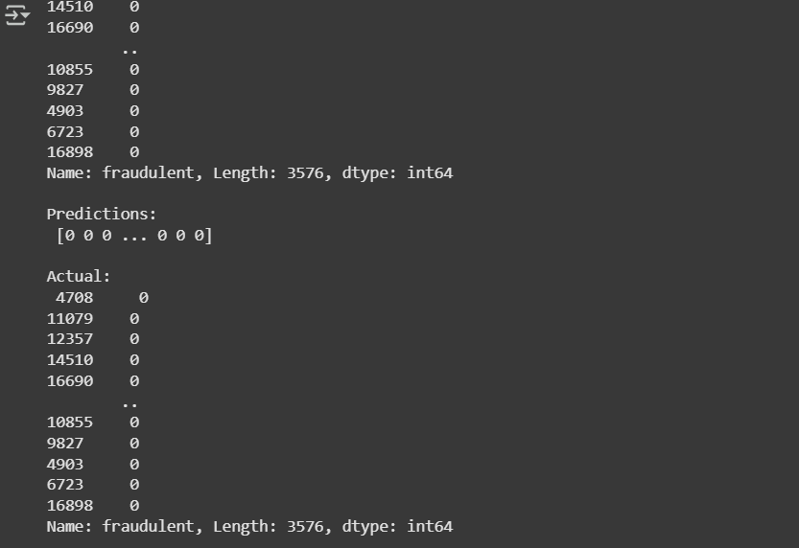

Slide 14
Summary
Cleaned job descriptions → TF-IDF → Logistic Regression
Model detects fraudulent job postings.
GITHUB - https://github.com/amishgarg1/Milestone-2.git

Slide 15
THANK YOU
Arja Raghuveer
Amish garg
Kemburu satyavathi
Jonnada Vennela

